Slide 1
News Portal Management
Submitted By:
Madhurya Dutta
18BC002

Slide 2
Contents
Introduction
Objective
ER Diagram
DFD
Screen Layout

Slide 3
Introduction
The purpose of the project is to develop an Online news system and provides news for all viewers.
All the news regarded to the category will be updated regularly by admin.
The idea is anyone can send a news item to the news website (which is managed by the administrator ) to make it visible for the Public.

Slide 4
Objective
The main objective of News Portal is that to provide the all type of instant and important news related to business, world, World Sports, national, Education etc.
This portal is open to public .Those people who don’t have time to read the newspaper can browse the desired news on the site.
Publish news about local region, town, city, state, national and inter- national. End user can upload news from any where at any time through web, mobile, tablets, etc.
People can view the news on the Home page without login.
News can be added or post only by the admin and only admin have the Authorized to update or delete any News.

Slide 5
ER Diagram
password
Email
username
id
id
name
description
Posting date
Updation Date
Admin
1
Manage
N
Post
1
Has
Category Id
CategoryName
Category Id
Sub Category Id
description
Subcategory Name
1
description
Subcategories
N
Has
M
Categories
Posting date
Posting date
Updation Date
Updation Date

Slide 6
Data Flow Diagram
Email,Pasword
Newsportal
news
Admin
Public
Response
browse

Slide 7
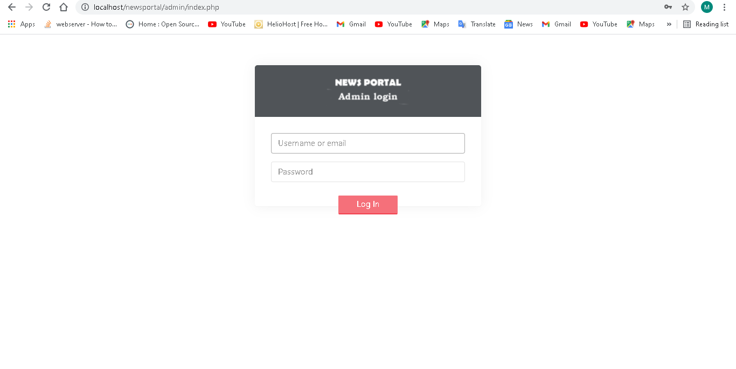
Admin Login

Slide 8
Conclusion
In this project work, an attempt has been made to develop a News or information based web site.
This project will helps the people and make them aware so that they can know any news any time.

Slide 9
Hardware Specification
Processor : AMD A6
RAM : 4 GB
Storage Capacity: 11.5GB
Software Specification
OS : Windows 10
Server : Xampp 7.4.3
Front End : HTML, CSS.
Back End: PHP , MySQL

Slide 10


